Slide 1
Anime RecommendationSystem
MEMBERS OF THE TEAM
KUNAL MALLICK
24167002
ANUSHKA KHATUA
24167030
AKANKHYA ABHISIKTA LENKA
24167008
SOHAM ADHIKARI
24167029

Slide 2
Overview
Develop an anime recommendation system using a deep learning model to provide personalized recommendations.
Key Features:
Utilizes advanced DL techniques.
Works with real-world anime datasets.
Enhances user engagement and satisfaction.

Slide 3
Motivation
Why build an anime recommendation system?
The growing popularity of anime worldwide.
Challenge of navigating massive anime libraries.
Lack of personalized recommendations in existing platforms.
Improve user experience and retention.
Significance:
Bridges the gap between users and their preferred anime genres.
Promotes lesser-known, high-quality anime.

Slide 4
problem formulation
Predict anime preferences for users based on historical data and content features.
Key Challenges:
High dimensionality of user-anime interaction data.
Sparse user preference matrices.
Diverse anime genres and user profiles.
Problem Statement:
"Given a dataset of users, anime items, and interactions, build a model to recommend the top 10 anime for each user."

Slide 5
dataset description
This data set contains information on user preference data from 73,516 users on 12,294 anime. Each user is able to add anime to their completed list and give it a rating and this data set is a compilation of those ratings.
Anime.csv (12294 rows × 7 columns)
anime_id - myanimelist.net's unique id identifying an anime.
name - full name of anime.
genre - comma separated list of genres for this anime.
type - movie, TV, OVA, etc.
episodes - how many episodes in this show.
rating - average rating out of 10 for this anime.
members - number of community members that are in this anime's "group".
Rating.csv (7813737 rows × 3 columns)
user_id - non identifiable randomly generated user id.
anime_id - the anime that this user has rated.
rating - rating out of 10 this user has assigned

Slide 6
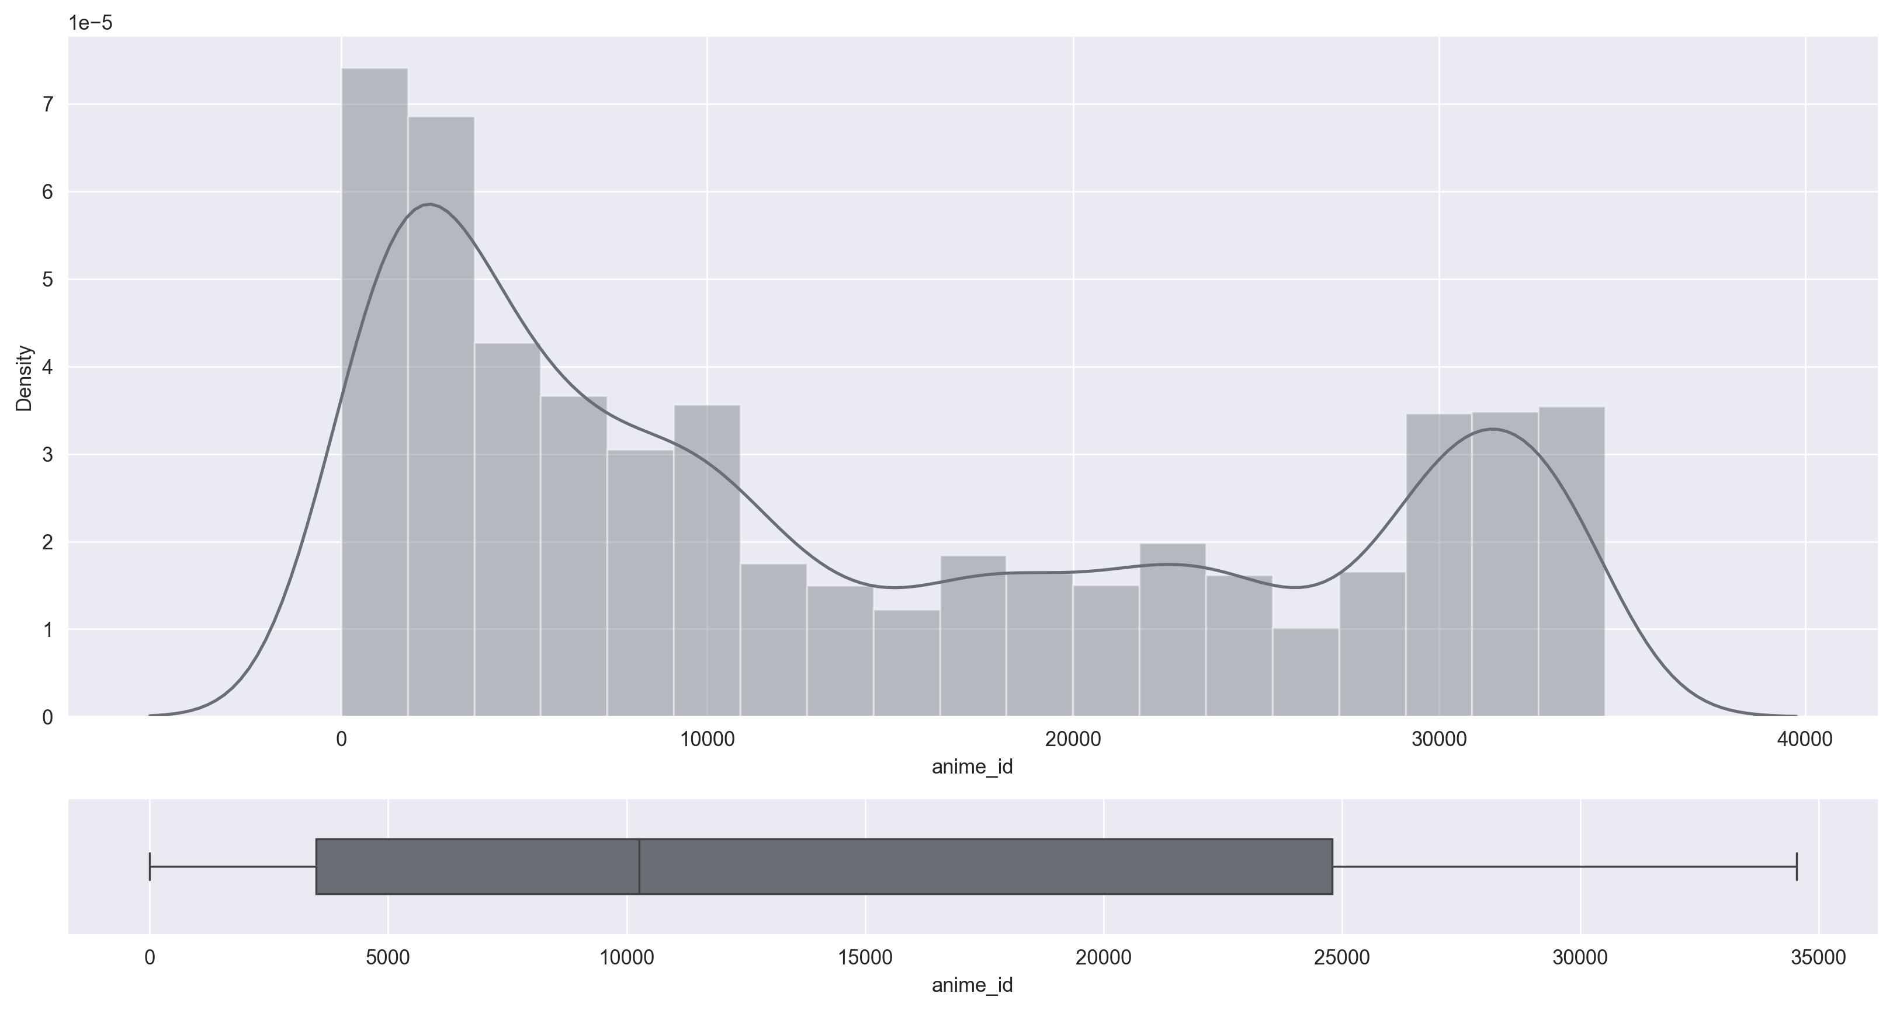
anime_id
type : int64
unique : 12294
min : 1
max : 34527
missing : 0(0.0%)

Slide 7
name
Type : object
unique : 12292
missing : 0(0.0%)

Slide 8
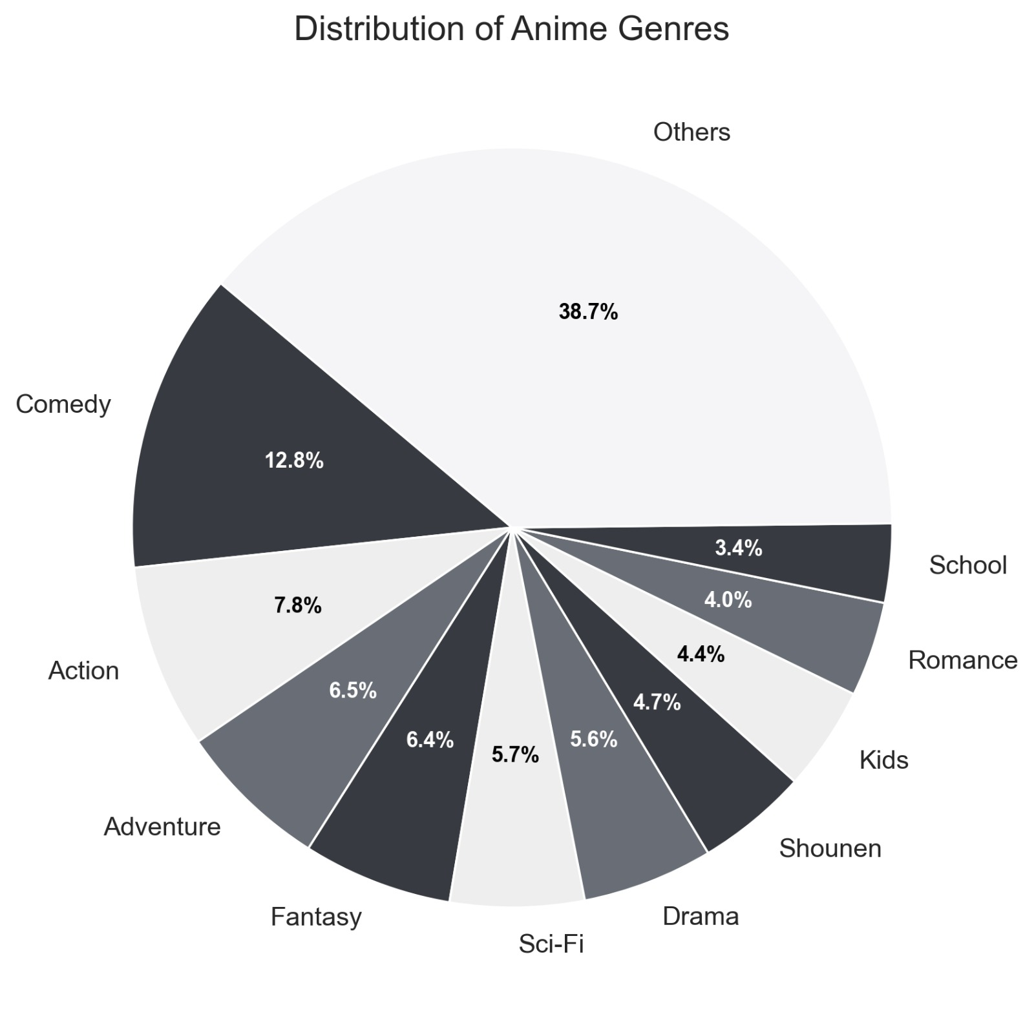
genre
Type : object
unique : 3265
missing : 62(0.5%)

Slide 9
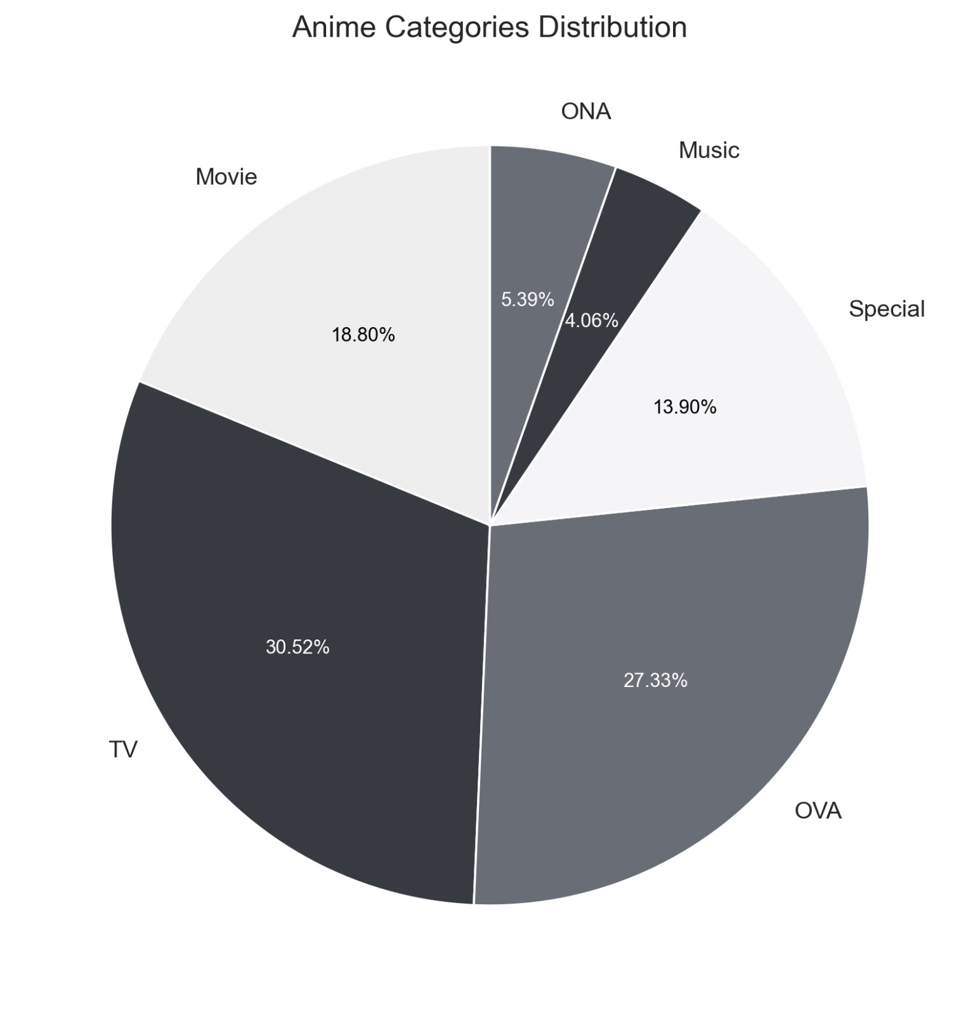
type
Type : object
unique : 6
missing : 25(0.2%)

Slide 10
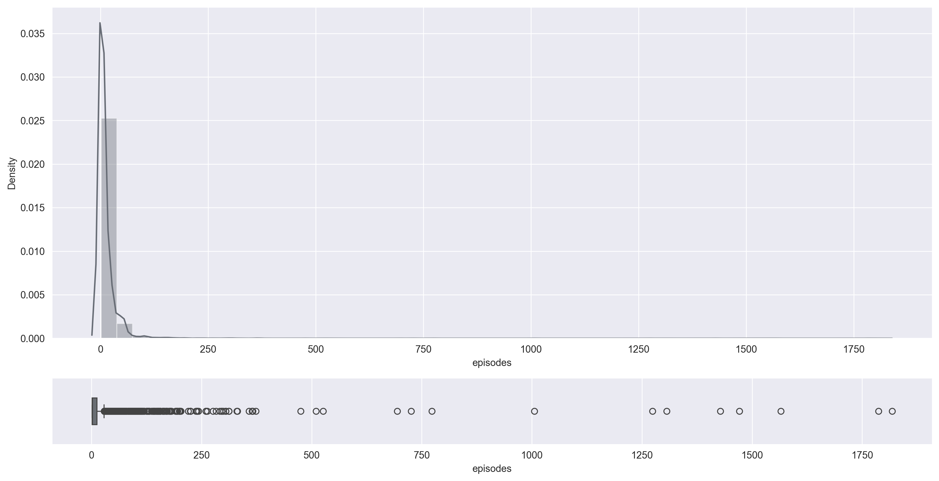
episodes
Type : int64
unique : 187
missing : 0(0.0%)

Slide 11
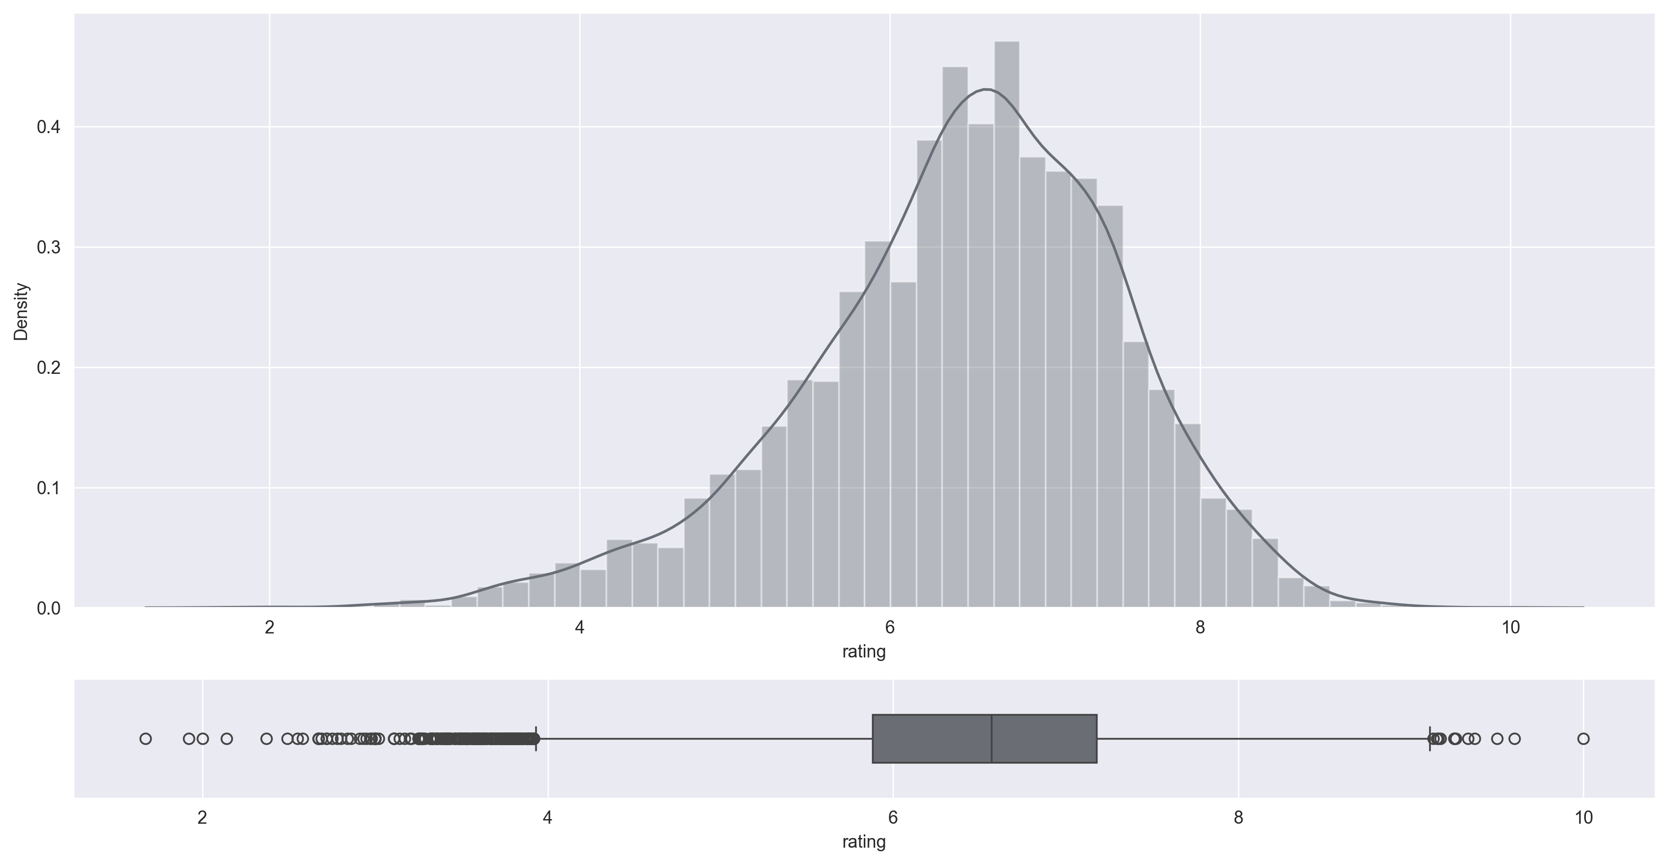
rating
type : float64
mean : 6.47
median : 6.57
std : 1.03
unique : 599
min : 1.67
max : 10.0
25% : 5.88
75% : 7.18
missing : 230(1.87%)
Outlier : 1.86%

Slide 12
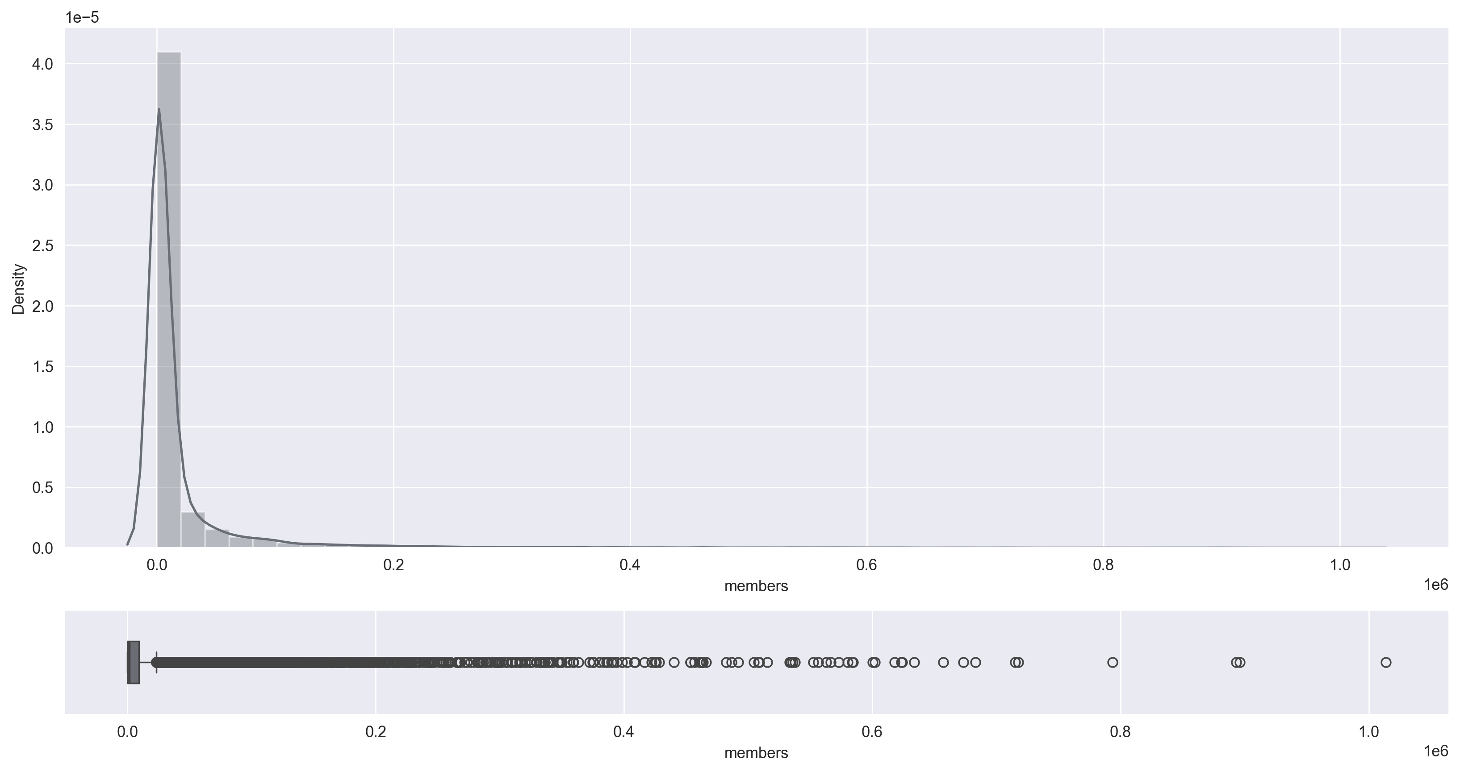
members
type : int64
mean : 18071.34
median : 1550.0
std : 54820.68
unique : 6706
min : 5
max : 1013917
25% : 225.0
75% : 9437.0
missing : 0(0.0%)

Slide 13
Analysing Anime

Slide 14
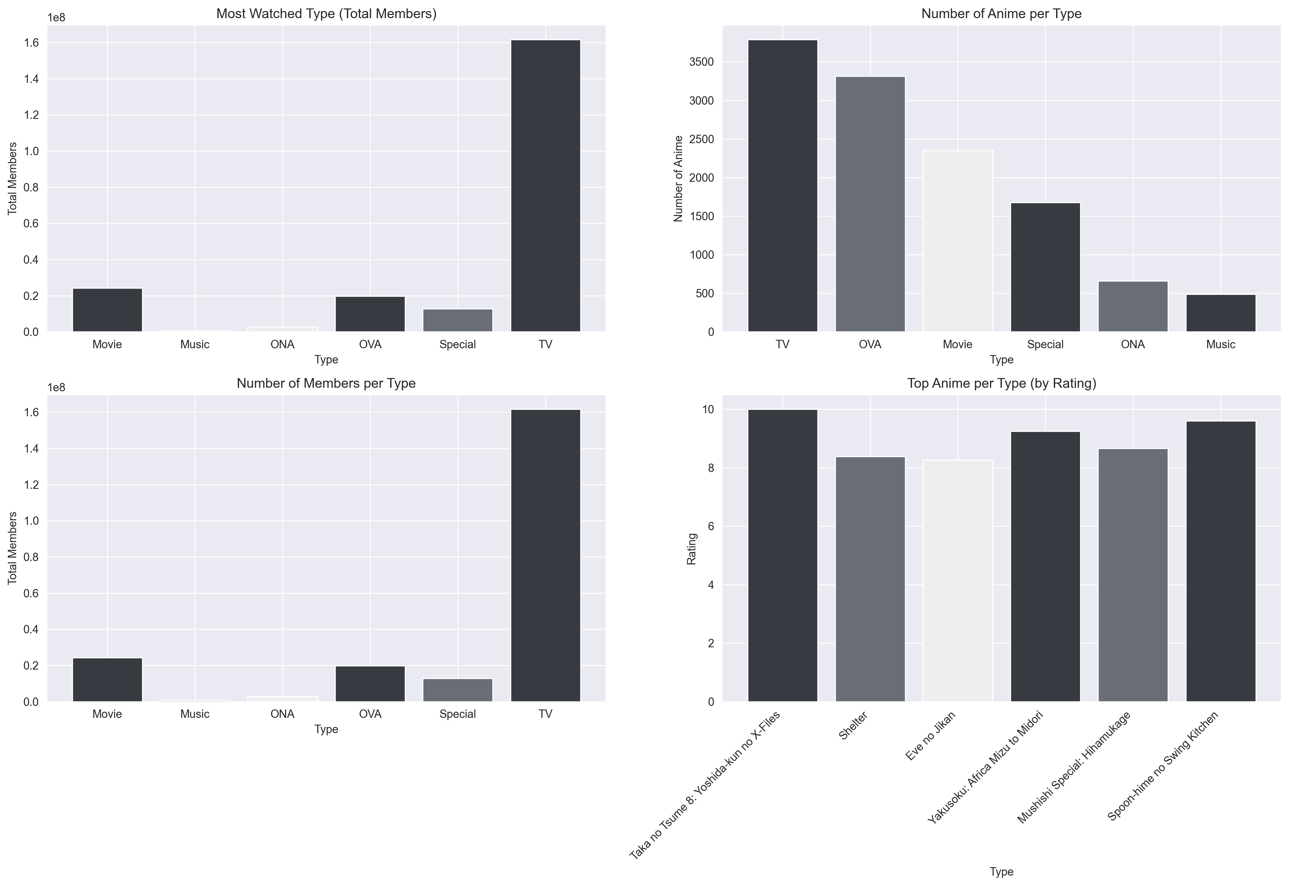
Analysing Type

Slide 15
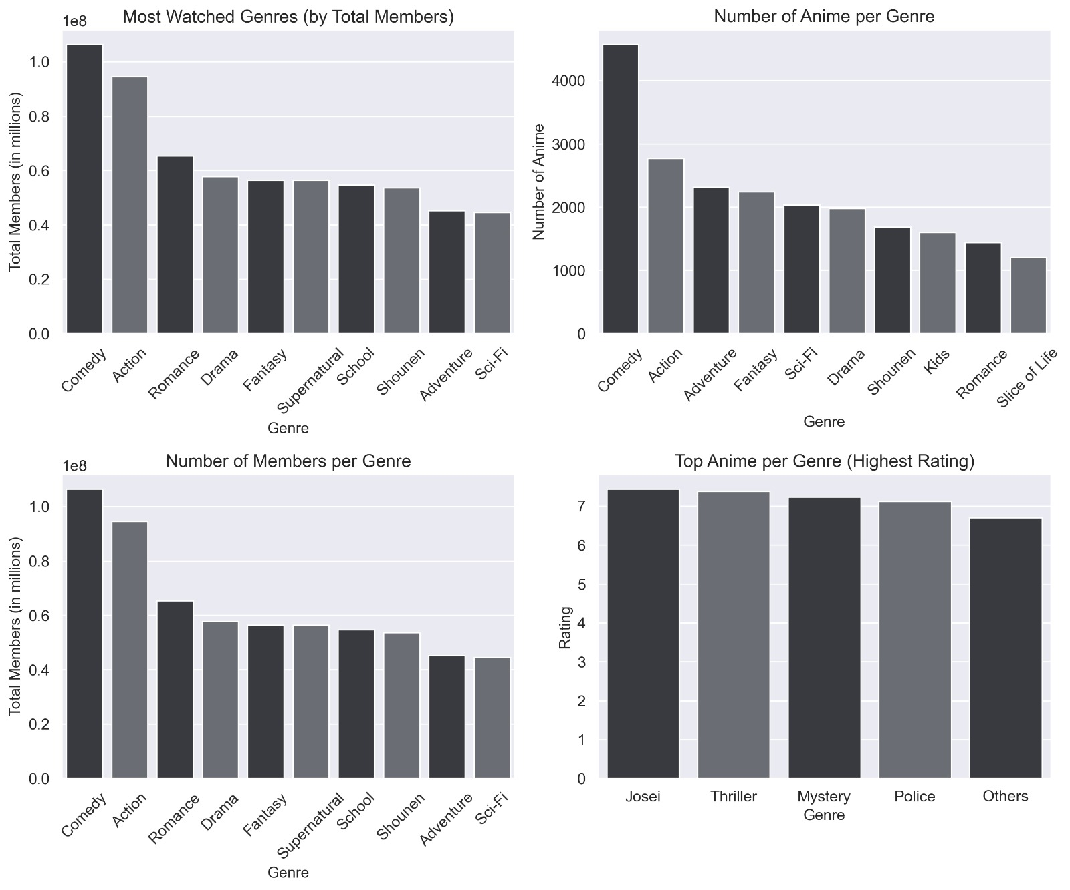
Analysing genre

Slide 16
Proposed Model Details
Model Architecture
In our model, we have applied Neural Collaborative Filtering (NCF).
2 Layers:
2 hidden layers one with 150 neurons and other with 50 neurons with relu as activation function
1 output layer with sigmoid activation function
we have used Adam optimizer

Slide 17
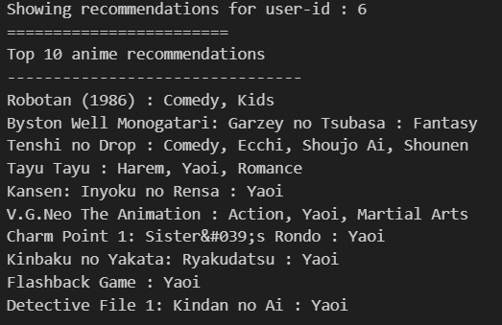
Result

Slide 18
alternate model
An alternative model has been constructed using user-user collaborative filtering. This model includes a pivot table and user-user matrix with cosine similarity.
pivot table :
We have constructed a pivot table with a column labeled "anime id," an index labeled "user_id," and a value of "rating”
user - user :
We have constructed a user-user matrix with a column labeled "user_id," an index labeled"user_id," and a value of cosine similarity value

Slide 19
pivot table
anime_id | 1 | 5 | 6 | 7 | 8 | 15 | 16 | 17 | 18 | 19 | ... | 34238 | 34239 | 34240 | 34252 | 34283 | 34324 | 34325 | 34349 | 34367 | 34475
user_id
1 | 0.0 | 0.0 | 0.0 | 0.0 | 0.0 | 0.0 | 0.0 | 0.0 | 0.0 | 0.0 | ... | 0.0 | 0.0 | 0.0 | 0.0 | 0.0 | 0.0 | 0.0 | 0.0 | 0.0 | 0.0
2 | 0.0 | 0.0 | 0.0 | 0.0 | 0.0 | 0.0 | 0.0 | 0.0 | 0.0 | 0.0 | ... | 0.0 | 0.0 | 0.0 | 0.0 | 0.0 | 0.0 | 0.0 | 0.0 | 0.0 | 0.0
3 | 0.0 | 0.0 | 0.0 | 0.0 | 0.0 | 0.0 | 0.0 | 0.0 | 0.0 | 0.0 | ... | 0.0 | 0.0 | 0.0 | 0.0 | 0.0 | 0.0 | 0.0 | 0.0 | 0.0 | 0.0
4 | 0.0 | 0.0 | 0.0 | 0.0 | 0.0 | 0.0 | 0.0 | 0.0 | 0.0 | 0.0 | ... | 0.0 | 0.0 | 0.0 | 0.0 | 0.0 | 0.0 | 0.0 | 0.0 | 0.0 | 0.0
5 | 0.0 | 0.0 | 8.0 | 0.0 | 0.0 | 6.0 | 0.0 | 6.0 | 6.0 | 0.0 | ... | 0.0 | 0.0 | 0.0 | 0.0 | 0.0 | 0.0 | 0.0 | 0.0 | 0.0 | 0.0
... | ... | ... | ... | ... | ... | ... | ... | ... | ... | ... | ... | ... | ... | ... | ... | ... | ... | ... | ... | ... | ...
36787 | 0.0 | 0.0 | 0.0 | 0.0 | 0.0 | 0.0 | 0.0 | 0.0 | 0.0 | 0.0 | ... | 0.0 | 0.0 | 0.0 | 0.0 | 0.0 | 0.0 | 0.0 | 0.0 | 0.0 | 0.0
36788 | 9.0 | 0.0 | 0.0 | 0.0 | 0.0 | 0.0 | 0.0 | 0.0 | 0.0 | 0.0 | ... | 0.0 | 0.0 | 0.0 | 0.0 | 0.0 | 0.0 | 0.0 | 0.0 | 0.0 | 0.0
36789 | 0.0 | 0.0 | 0.0 | 0.0 | 0.0 | 0.0 | 0.0 | 0.0 | 0.0 | 0.0 | ... | 0.0 | 0.0 | 0.0 | 0.0 | 0.0 | 0.0 | 0.0 | 0.0 | 0.0 | 0.0
36790 | 0.0 | 0.0 | 0.0 | 0.0 | 0.0 | 0.0 | 0.0 | 0.0 | 0.0 | 0.0 | ... | 0.0 | 0.0 | 0.0 | 0.0 | 0.0 | 0.0 | 0.0 | 0.0 | 0.0 | 0.0
36791 | 0.0 | 0.0 | 0.0 | 0.0 | 0.0 | 0.0 | 0.0 | 0.0 | 0.0 | 0.0 | ... | 0.0 | 0.0 | 0.0 | 0.0 | 0.0 | 0.0 | 0.0 | 0.0 | 0.0 | 0.0

Slide 20
user - user
 | 1 | 2 | 3 | 4 | 5 | 6 | 7 | 8 | 9 | 10 | ... | 36782 | 36783 | 36784 | 36785 | 36786 | 36787 | 36788 | 36789 | 36790 | 36791
1 | 0.000000 | 0.000000 | 0.101277 | 0.0 | 0.028218 | 0.0 | 0.079514 | 0.153449 | 0.000000 | 0.278011 | ... | 0.000000 | 0.000000 | 0.120550 | 0.000000 | 0.032543 | 0.140359 | 0.050656 | 0.083858 | 0.000000 | 0.000000
2 | 0.000000 | 0.000000 | 0.135037 | 0.0 | 0.000000 | 0.0 | 0.000000 | 0.000000 | 0.000000 | 0.000000 | ... | 0.000000 | 0.000000 | 0.000000 | 0.000000 | 0.000000 | 0.000000 | 0.000000 | 0.000000 | 0.000000 | 0.000000
3 | 0.101277 | 0.135037 | 0.000000 | 0.0 | 0.204494 | 0.0 | 0.153641 | 0.074136 | 0.000000 | 0.203559 | ... | 0.038336 | 0.097274 | 0.100114 | 0.121223 | 0.039111 | 0.060651 | 0.234722 | 0.245566 | 0.000000 | 0.013002
4 | 0.000000 | 0.000000 | 0.000000 | 0.0 | 0.000000 | 0.0 | 0.000000 | 0.000000 | 0.000000 | 0.000000 | ... | 0.000000 | 0.000000 | 0.000000 | 0.000000 | 0.000000 | 0.000000 | 0.000000 | 0.000000 | 0.000000 | 0.000000
5 | 0.028218 | 0.000000 | 0.204494 | 0.0 | 0.000000 | 0.0 | 0.243342 | 0.046187 | 0.028218 | 0.005230 | ... | 0.074472 | 0.115497 | 0.063214 | 0.075550 | 0.112185 | 0.008977 | 0.207466 | 0.084961 | 0.018812 | 0.031586
... | ... | ... | ... | ... | ... | ... | ... | ... | ... | ... | ... | ... | ... | ... | ... | ... | ... | ... | ... | ... | ...
36787 | 0.140359 | 0.000000 | 0.060651 | 0.0 | 0.008977 | 0.0 | 0.028409 | 0.086151 | 0.000000 | 0.312170 | ... | 0.000000 | 0.000000 | 0.067681 | 0.000000 | 0.018271 | 0.000000 | 0.048754 | 0.114339 | 0.000000 | 0.030408
36788 | 0.050656 | 0.000000 | 0.234722 | 0.0 | 0.207466 | 0.0 | 0.090391 | 0.031092 | 0.000000 | 0.096568 | ... | 0.041088 | 0.133358 | 0.123003 | 0.076685 | 0.134469 | 0.048754 | 0.000000 | 0.168181 | 0.000000 | 0.048078
36789 | 0.083858 | 0.000000 | 0.245566 | 0.0 | 0.084961 | 0.0 | 0.056461 | 0.125002 | 0.000000 | 0.093254 | ... | 0.000000 | 0.112723 | 0.195682 | 0.242577 | 0.021442 | 0.114339 | 0.168181 | 0.000000 | 0.000000 | 0.023070
36790 | 0.000000 | 0.000000 | 0.000000 | 0.0 | 0.018812 | 0.0 | 0.057828 | 0.000000 | 0.000000 | 0.000000 | ... | 0.000000 | 0.000000 | 0.000000 | 0.000000 | 0.000000 | 0.000000 | 0.000000 | 0.000000 | 0.000000 | 0.000000
36791 | 0.000000 | 0.000000 | 0.013002 | 0.0 | 0.031586 | 0.0 | 0.053246 | 0.025857 | 0.000000 | 0.000000 | ... | 0.000000 | 0.015038 | 0.088507 | 0.061742 | 0.015863 | 0.030408 | 0.048078 | 0.023070 | 0.000000 | 0.000000
 | user-1 | user-2
 | 1 | 1776
 | 2 | 671
 | 3 | 13920
 | 4 | 1
 | 5 | 27040
 | ... | ...
 | 36787 | 19002
 | 36788 | 4427
 | 36789 | 9065
 | 36790 | 1227
 | 36791 | 10833

Slide 21
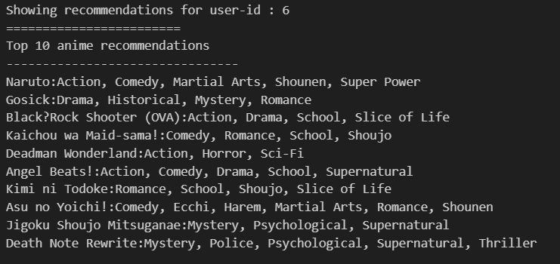
Result

Slide 22
conclusion
Traditional collaborative filtering struggles with cold-start problem
NCF has the ability to learn from raw data and capture complex user-item interactions
NCF also captures non-linear relationships between users and items
NCFs offer flexibility in modeling various types of data and interactions, are highly scalable and can handle large-scale datasets efficiently

Slide 23
Repository link
https://github.com/kunal-mallick/Anime_Recommendations_System
bibilography
https://arxiv.org/pdf/1708.05031v2
https://medium.com/@omar.tafsi_46401/5-mins-recommender-systems-neural-collaborative-filtering-094f6a25f0af
https://towardsdatascience.com/neural-collaborative-filtering-96cef1009401
https://medium.com/data-science-in-your-pocket/recommendation-systems-using-neural-collaborative-filtering-ncf-explained-with-codes-21a97e48a2f7

Slide 24
Thank you

